Slide 1
Unit Testing
Intro to Junit, Mockito and why we even test

Slide 2
Practical information
We have one assignment which will be graded at the end of the course, upon submission
After each lesson, you will be able to implement a part of the assignment
We recommend to do it gradually
At the beginning of each lesson, we will do a "refresher" of the previous topic. Come with a smartphone
Each lesson includes some practice. Be here with a laptop and enough battery
Tooling:
VS Code or IntelliJ Idea
Java 21
Git
Setup everything by using the "cook-books" from oop-2: https://appliedmath.toi.inholland.nl/oop-2-code-projects/cook-books

Slide 3
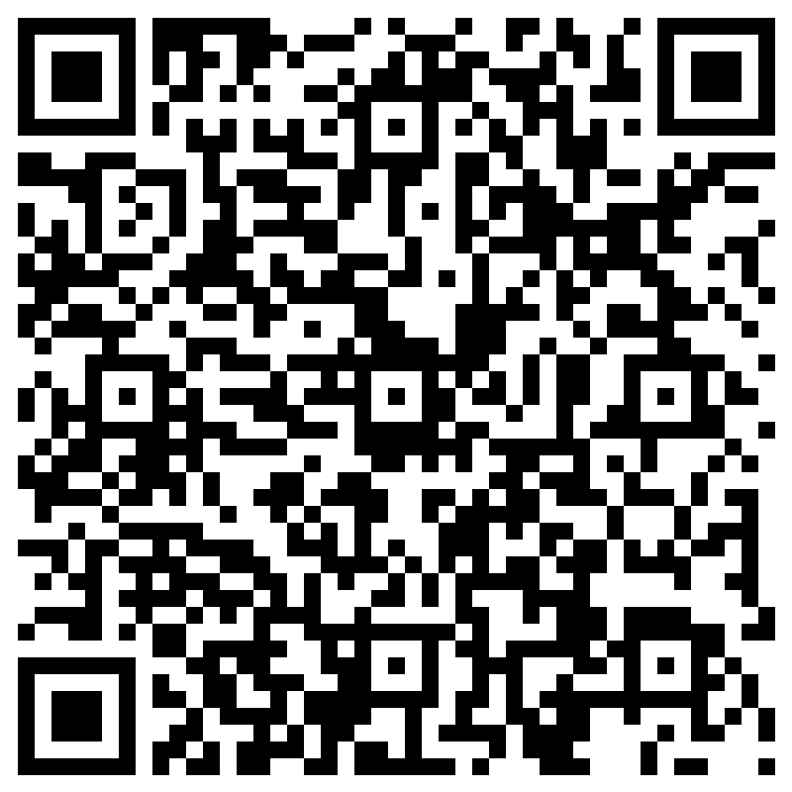
Recap of last week

Slide 4
Objectives
Get an understanding what Unit Testing is
Understand why we Unit Test
Learn about different Unit Testing Frameworks
Get hands on experience in Unit Testing

Slide 5
Objectives
Code examples can be found here

Slide 6
The Testing Pyramid
A conceptual model that illustrates the ideal distribution of automated tests
Emphasizes having more unit tests, fewer integration tests, and even fewer UI/end-to-end tests

Slide 7
UI / End to End Tests
Simulate real user interactions (e.g., clicking buttons, submitting forms)
Use tools like Selenium or Cypress
Slowest and most brittle type of test
Use sparingly for critical user flows

Slide 8
Integration/Component Tests
Integration
Test how multiple components work together
Component
Test how an entire application flow works
May involve databases, file systems, or APIs
Slower and more complex than unit tests

Slide 9
What is a Unit Testing?
Definition: Unit testing is the process of testing individual units or components of a program in isolation
Units are usually methods within a class
Unit tests are automated and repeatable, they should always have the same result

Slide 10


What is in scope of a Unit Testing?
public class PersonService {
private final PersonRepository personRepository;
private final ImageService imageService;
[ . . . ]
}
Only 1 class is in scope
Collaborators of your class are not in scope (they have their own dedicated unit tests)

Slide 11
Why do we Unit Test?
Catch bugs early
Enable safe refactoring
Serve as documentation
Improve code quality and confidence
Facilitate continuous integration
Fast and cheap way of testing an application
Notes:
Log4j!

Slide 12
Why do we Unit Test?
public class PersonService {
private final PersonRepository personRepository;
private final ImageService imageService;
public List<Person> getAllPeople() {
return personRepository.findAll();
}
}
Would you write a unit test for this method?

Slide 13
Why do we Unit Test?
“We don’t write tests for what is now, To prove today’s code stands somehow. We write them for the days ahead, When future hands will tread instead.
For change will come, as change must do, And shift the old to something new. Our tests will guard, our tests will guide, So software stands the changing tide.”
Anonymous
Notes:
Log4j!

Slide 14
Why do we Unit Test?
public class PersonService {
private final PersonRepository personRepository;
private final ImageService imageService;
public List<Person> getAllPeople() {
return personRepository.findAll();
}
}
Would you write a unit test for this method?
YES!!

Slide 15
What makes a good Unit Test?
Fast – should run quickly
Isolated – no external dependencies (e.g., DB, network)
Repeatable – same result every time
Clear – easy to understand and maintain
Focused – tests one thing only

Slide 16
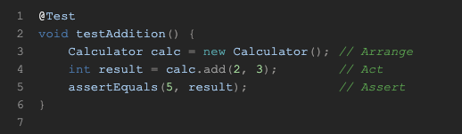
What does a Unit Test look like?
Arrange: Set up the test data and environment
Act: Call the method under test
Assert: Check the result

Slide 17
Junit 5
A popular Java testing framework
Used to write and run automated unit tests
Test run in the maven lifecycle step “test”

Slide 18
JUnit test structure
@Test marks a test method
assertEquals(expected, actual) checks the result
@Test void testAddition() { Calculator calc = new Calculator(); // Arrange int result = calc.add(2, 3); // Act assertEquals(5, result); // Assert }

Slide 19
Common assertions
assertEquals(expected, actual)
assertTrue(condition)
assertFalse(condition)
assertThrows(Exception.class, () -> ...)

Slide 20
Test Lifecycle
@BeforeEach – runs before each test
@AfterEach – runs after each test
@BeforeAll – runs once before all tests (static)
@AfterAll – runs once after all tests (static)

Slide 21
Naming and Structuring
Use descriptive method names: shouldAddTwoNumbersCorrectly()
Group related tests in the same class
Keep tests small and focused
Use @DisplayName for even clearer naming

Slide 22
Running tests
Manually
In IDE
Automated
In the Maven build cycle
As part of a deploy pipeline

Slide 23

Short break – See you in 5 minutes

Slide 24
Mockito
Popular library for creating and managing mock objects
Focus on testing logic, not setup
Avoid slow or flaky external dependencies
Verify interactions between objects

Slide 25
Mockito Annotations
@Mock: Declares a mock object
@InjectMocks: Injects mocks into the object under test
@BeforeEach: Initializes mocks using MockitoAnnotations.openMocks(this);

Slide 26
Mocking
Creating an imitation of a real class
Control the behavior and track interactions

Slide 27
Why do we Mock?
Isolation
Only test the class under test – no collaborators
Collaborators might have their own bugs
Focus on interaction with collaborators without depending on their real execution
No unintended side effects
Speed
Mocks are faster than real services (DB interactions)
Control
You decide what the mock does
Easy to simulate edge cases
Verification
Check if certain methods are called

Slide 28
Stubbing
Controlling what a mock returns
All calls to mocks should be stubbed
when(bookRepo.findBookById(any())).thenReturn(new Book("Mockito 101"));

Slide 29
Verify/Spy
Check if a method is called on a mock
Verify
Check if a method is called on a class under test
Spy
public class UserServiceTest { @Mock NotificationService mockNotificationService; UserService userService; UserService spyUserService; @BeforeEach void setUp() { MockitoAnnotations.openMocks(this); userService = new UserService(mockNotificationService); spyUserService = spy(userService); // Spy on the class under test } @Test void testRegisterUserSendsNotification() { // Act spyUserService.registerUser("user123"); // Verify interaction with the mocked dependency verify(mockNotificationService).send("user123", "Welcome!"); // Optionally verify internal method call on the spy verify(spyUserService).notifyUser("user123"); } }

Slide 30
How to get started
Create test class
IntelliJ: command + shift + T
Group related tests in the same class
Keep tests small and focused
Use @DisplayName for even clearer naming

Slide 31
Assignment
Add Unit Tests to the PersonService

Slide 32
Code Coverage – Jacoco plugin
Include the plugin in the Pom to generate code coverage reports
<plugin> <groupId>org.jacoco</groupId> <artifactId>jacoco-maven-plugin</artifactId> <version>0.8.13</version> <executions> <execution> <goals> <goal>prepare-agent</goal> </goals> </execution> <execution> <id>report</id> <phase>verify</phase> <goals> <goal>report</goal> </goals> </execution> </executions> </plugin>

Slide 33
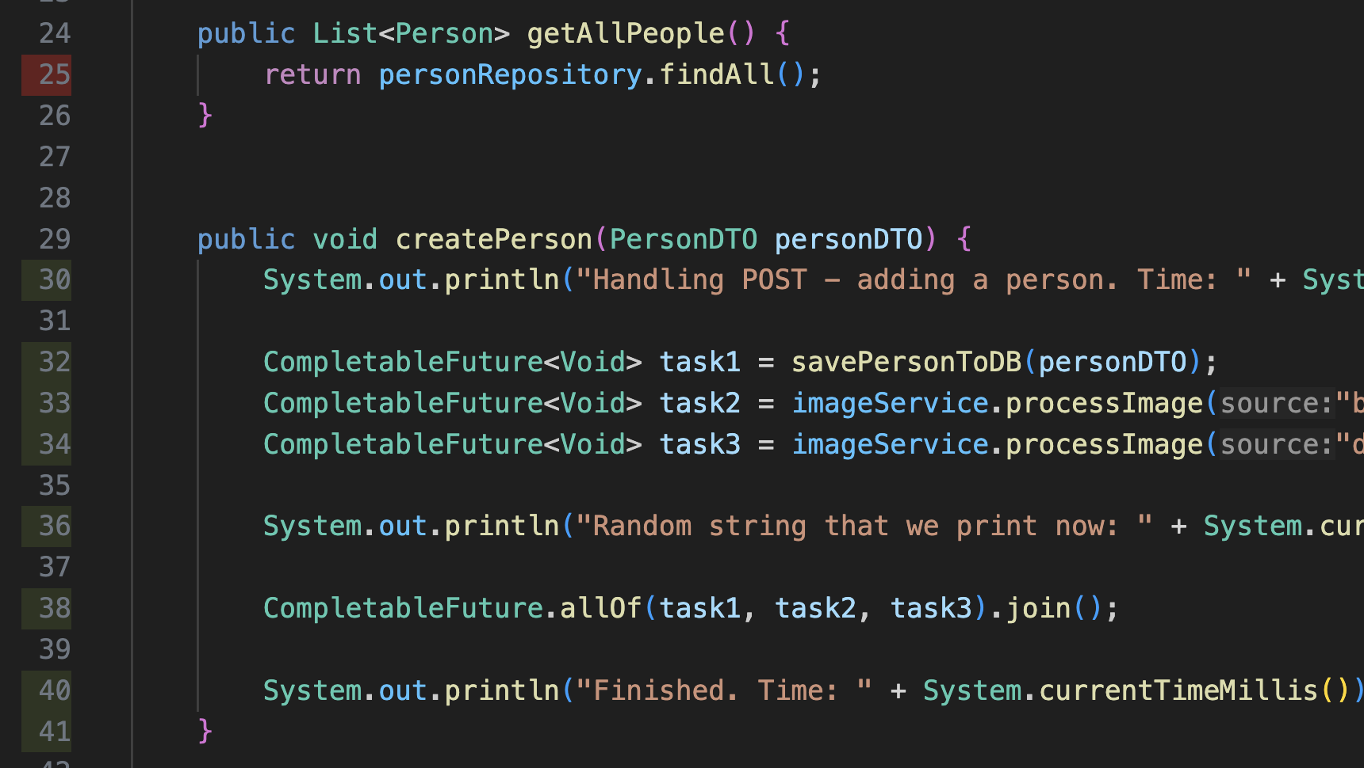


Code coverage - Line coverage
uncovered
The line coverage is about which line have been executed, therefor they are “covered”, and which ones haven’t
covered

Slide 34

Code coverage - Branch coverage
public void deletePerson(UUID id) {
Optional<Person> removePerson = personRepository.findById(id);
removePerson.ifPresent(person -> personRepository.delete(person));
}

Slide 35
Short break – See you in 5 minutes

Slide 36
Mutation Testing
Evaluate the quality of your unit tests by introducing small changes (mutations) in the code and checking if the tests catch them
Ensure that your tests are meaningful and not accidentally passing

Slide 37
How does it work?
Mutator changes code
+ to –
True to False
> to <
Etc.
Reruns the tests
Test fails: mutation killed
Test passes: mutation survived
Mutation score = (killed / total mutants) x 100%

Slide 38
How to implement it?
Use a plugin
PIT

Slide 39
Test Driven Development
Definition: A software development approach where tests are written before the code.
Core Idea: Write a failing test → Write just enough code to pass → Refactor.
Goal: Ensure code correctness from the start.

Slide 40
Why use TDD?
Benefits
Forces you to think about requirements first
Leads to better-designed, loosely coupled code
Provides a safety net for refactoring
Improves confidence in code changes
Bonus: Acts as living documentation

Slide 41
Challenges of TDD
Initial Slowness
Takes time to get used to the workflow
Over-testing
Risk of writing unnecessary tests
Design Constraints
May lead to over-engineering if not balanced

Slide 42
Homework
After each lesson, you get a piece of homework that serves as implementation of the final assignment.
After lesson 5, we can now add unit tests to our application
The homework is to do it. Add unit tests to your assignment.
Try to achieve 90% of line coverage

